Slide 1
Week 1 – Let There Be Light!

Slide 2
Important Terms
Electrons
  Super tiny, fundamental particles with a negative, electrical charge
Electricity & Electrons
  The flow of electrons from one place to another – lightning is the flow of electrons clouds to the ground
Voltage
  The electrical force that forces electrons to move
Resistance
Current

Slide 3
Important Terms
Breadboard
Arduino
  A small processor used to:
    Talk to the computer
    Read sensors
    Control motors
Pin
  The place where wires can connect to the Arduino and the signals can be sent or received

Slide 4
Circuits & LEDs

Slide 5
Introduction
LED (light emitting diodes) provide light for many things in our world today, for example:
  Car tail lights
  LED bulbs at home
  The screen of your computer
  The big screen at the hockey game and advertising boards

Slide 6
Important Terms
LED
  Light Emitting diode
Resistor
  Helps control current flow

Slide 7
Objectives
Learn about:
  Arduino
  Circuits
  LEDs
  Resistors
Create a circuit with an LED

Slide 8
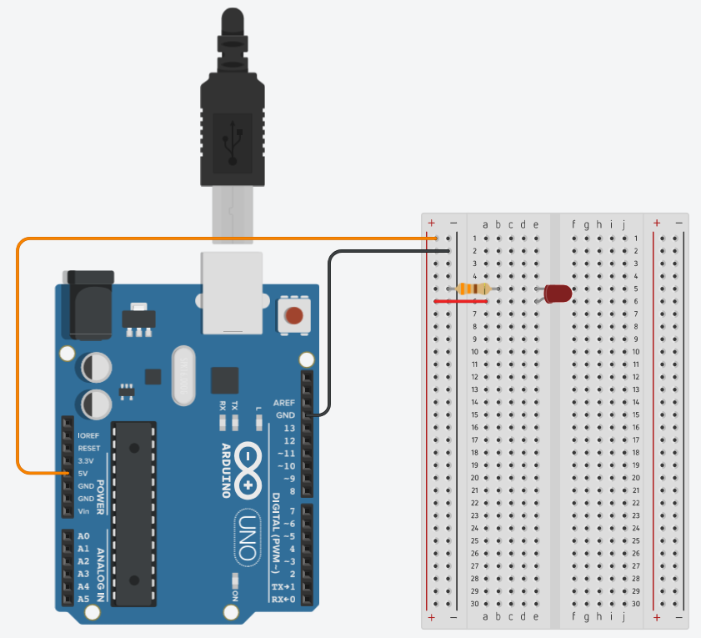
Activity - Circuit
Materials:
  Arduino
  LED
  Resistor
  Wires
Resistor
Requirements!

Slide 9
Challenges
Turn on the LED
Bonus:
  What happens when the LED is connected backwards?
  What happens when different resistor values are used?

Slide 10
Important Terms

Slide 11
Blink & Programming

Slide 12
Introduction
Now that we can get an LED to turn on, we need to give the Arduino control to turn the LED on & off.
An example where this occurs is traffic lights. We need to control which light is on to send directions to drivers.

Slide 13
Important Terms
Digital Voltage
  A voltage that can only be 1 of 2 values
  For Arduinos, this is 0 volts or 5 volts
Digital Pin
  This is a pin that can be turned On or Off.
    On – it outputs a high voltage (5 volts) and creates a current
    Off – it outputs a low voltage (0 volts or Ground) and does not create a current

Slide 14
Objectives
Modify the circuit so the Arduino can turn on & off the LED
Create a program that the Arduino can run which will control the LED

Slide 15
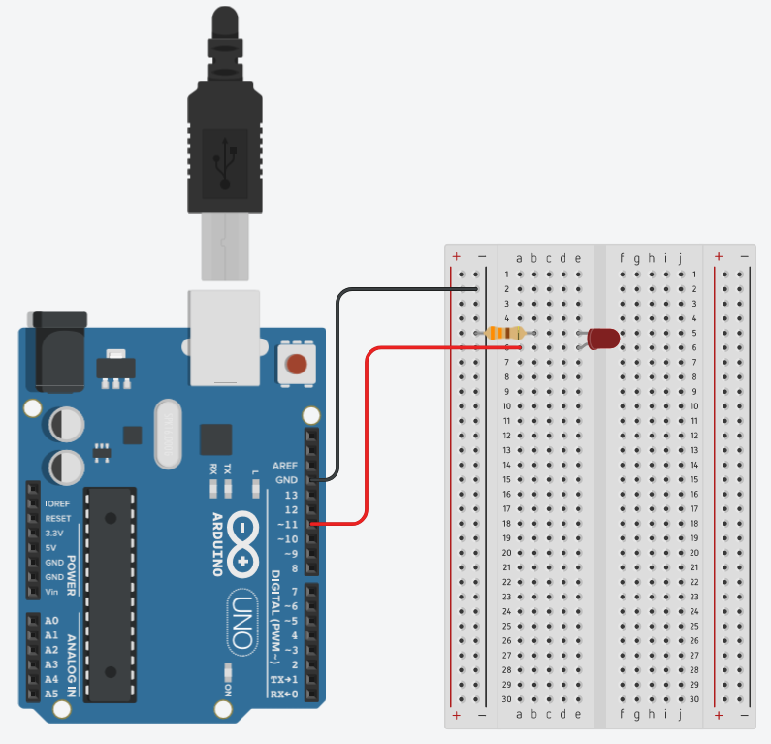
Activity - Circuit
Move the wire providing power from the 5v pin to pin 11
Pin 11 is a digital output pin which means we can turn it on & off using a program

Slide 16
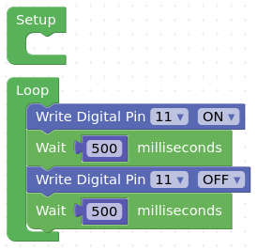
Activity - Program
Turn the LED on
Wait...
Turn the LED off
Wait...
& Repeat forever!

Slide 17
Challenges
Make the LED blink
Bonus:
  Can you make the LED blink and be controlled on pin 13?
  If you’re successful with pin 13, you should see an LED blinking on the Arduino along with the LED in your circuit...

Slide 18
Important Terms
Functions
  A block of code that performs a specific action and we call make a “function call” to execute that specific action
  It helps keep our program cleaner and easier to read

Slide 19
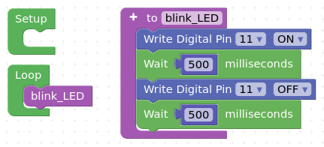
Activity - Program
Functions make it easy to group code for a specific purpose into a clear block of code

Slide 20
Challenges
Modify the program to
use a function
Bonus:
  What happens when you change the amount of time the Arduino waits between on/off steps?
  Try reducing the time to 15 microseconds in both Wait blocks. Can you see the LED turn on & off?

Slide 21
Traffic Lights

Slide 22


Introduction
Traffic lights keep the roads safe and are a very simple system to tell drivers when they can safely go or when they must stop!

Slide 23
Objectives
Create a process outline
Learn how to automate a process or sequence
Build a traffic light that operates like a real one

Slide 24
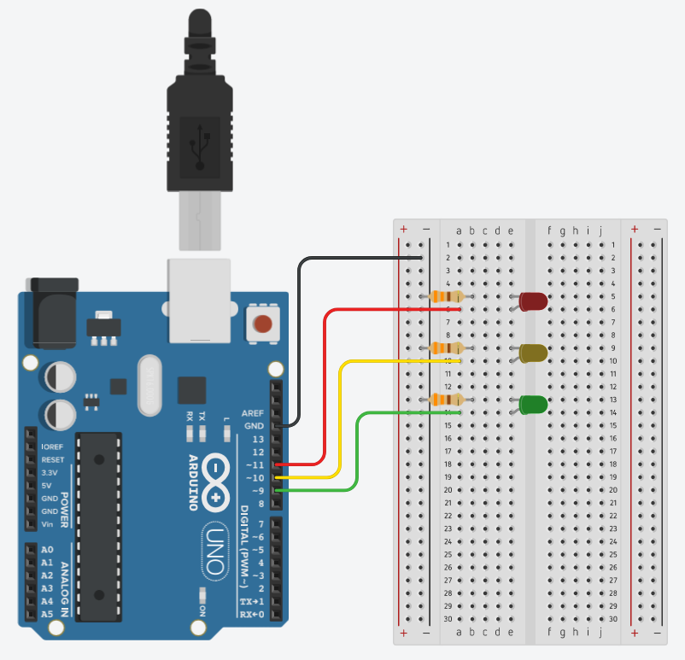
Activity - Circuit
Materials
  3x LEDs
    Red
    Yellow
    Green
  3x Resistors
  Wires

Slide 25
Activity - Program
What is the process that the lights must use to work like a normal traffic light?
What order do the lights turn on?
How long should the lights be on for?

Slide 26
Challenge
Using the process outline that you created for the traffic lights, can you use the example code for the Blink program to automate your traffic lights?
Use this example code -->
Does your code work the way that you expect it to?

Slide 27
Potentiometers

Slide 28
Introduction
Potentiometers are important pieces of electronics that allow humans to make changes that computers, and Arduinos, can make measurements of and then take specific actions as a result
For example, when you move a joystick to the side, you are moving a potentiometer which the controller can measure and then the game can move your character in the video game world

Slide 29
Important Terms
Potentiometer (pot)
  A type of resistor that changes it value by turning a dial or moving a slider
  Ex.
    Joystick controllers
    Volume control on a radio
Serial Communication
  This is how computers talk to each other using USB cables
  Your computer programs the Arduino using Serial
  Your Arduino sends back messages using Serial

Slide 30
Important Terms
Analog Voltage
  A voltage that can be any value
    Ex. 0 volts, 2.95 volts, 5 volts
Analog Pin
  A pin used to make analog measurements

Slide 31
Objectives
Learn what a potentiometer is
Create a circuit that allows the Arduino to measure the potentiometer’s value
Plot the measurement on the computer so we can see

Slide 32
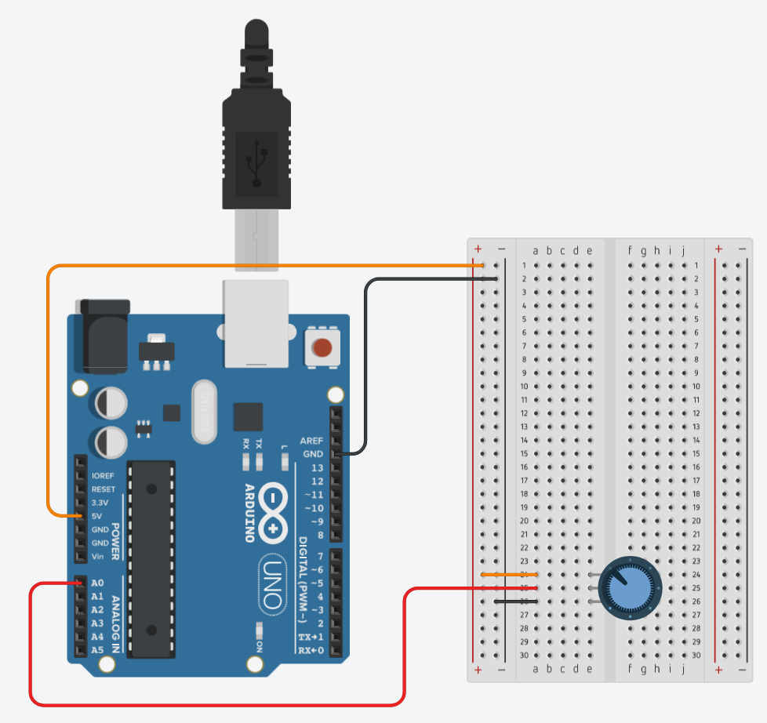
Activity - Circuit
The Arduino is providing power
The Arduino measures the potentiometers value using pin A0

Slide 33
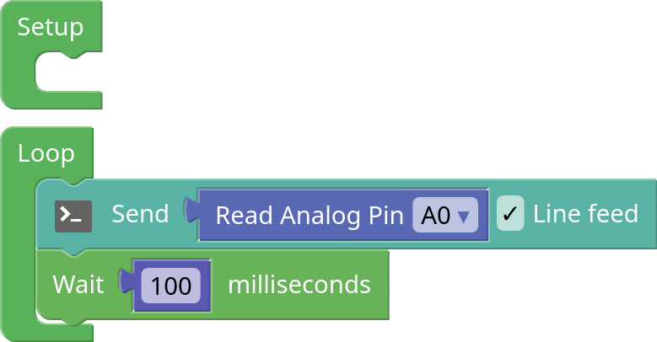
Activity - Program
Measure the potentiometers value using pin A0
Send the measurement value to the Arduino
Wait 100 milliseconds before taking another measurement

Slide 34
Challenges
Turn the potentiometer and see how the plot changes.
What is the maximum and minimum values you see in the plot? Are they what you expect them to be?
What happens if you change the wait time to 30 milliseconds?

Slide 35
Controlling LED Brightness
Resistors

Slide 36
Introduction
Car tail lights need to be able to be dimly lit so people can see the backs of cars at night, but very bright when people apply the brakes.
How do you make LEDs have 2 different brightness levels?

Slide 37
Objectives
Learn how to made an LED brighter & dimmer using resistors

Slide 38
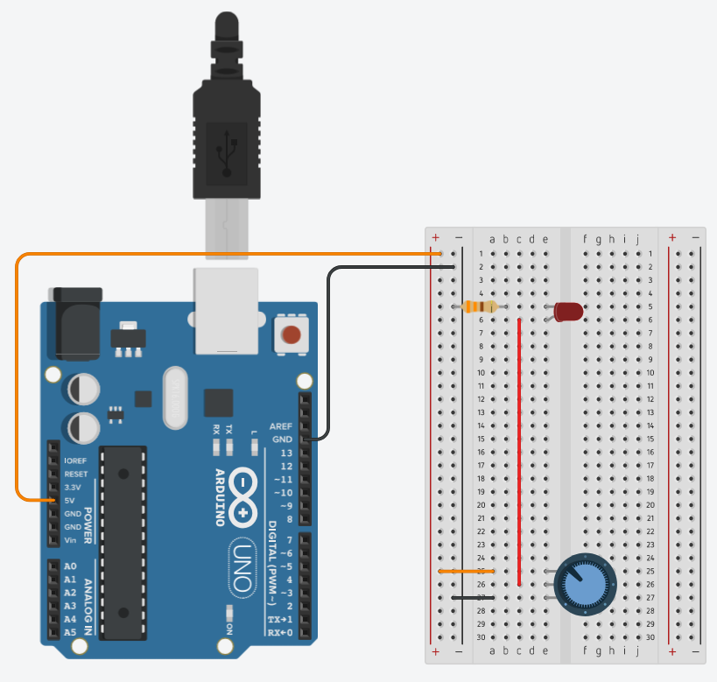
Activity - Circuit
This is basically the same as the first circuit that we made where the LED is simply powered by the Arduino

Slide 39
Challenges
Try using the program we just used for to plot the potentiometer value. This will require you to connect the potentiometer output (middle pin) to the Arduino’s pin A0.
At what value of the potentiometer is the LED completely dark?

Slide 40
Controlling LED Brightness
PWM – Pulse Width Modulation

Slide 41
Introduction
How do you control the brightness of an LED using an Arduino?

Slide 42
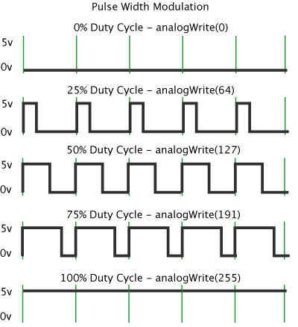
Important Terms
Pulse Width Modulation (PWM)
  This is a signal that turns on & off very quickly
  We can set the amount of time that the signal will be on verses off

Slide 43
Objectives
Learn what a Pulse Width Modulated (PWM) signal is
Learn how to make an LED brighter & dimmer using PWM signals

Slide 44
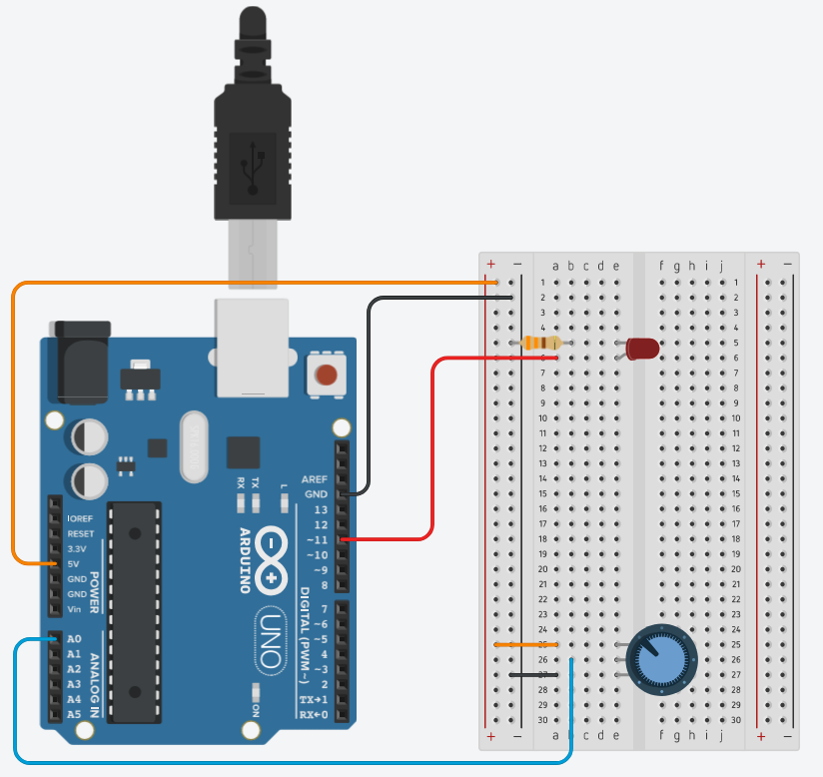
Activity - Circuit
Connect the pot to pin A0
Power the LED using pin 11

Slide 45
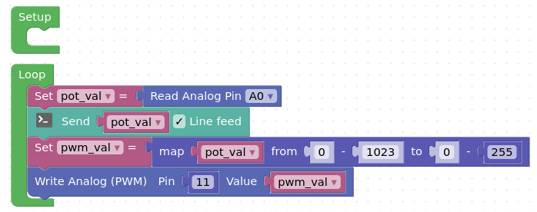
Activity - Program
Measure the potentiometer value
Send the pot value back to the computer so we can plot it
Calculate the required PWM value
Output the PWM value using pin 11

Slide 46
Challenges

Slide 47
Goals

Slide 48
Goals

Slide 49
Goals

Slide 50
Goals

Slide 51
Goals

Slide 52
Goals

Slide 53
Goals

Slide 54
Goals

